Slide 1
Subsea Services Inc.
Internal Project
Web site
07 Sep 2016

Slide 2
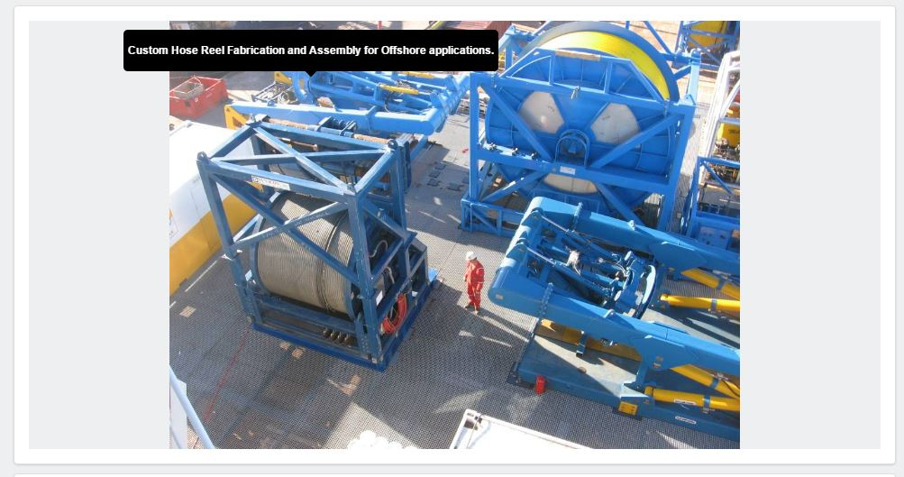

Comment-1
Please add the image order like highlighted on the right side screen shot.

Slide 3
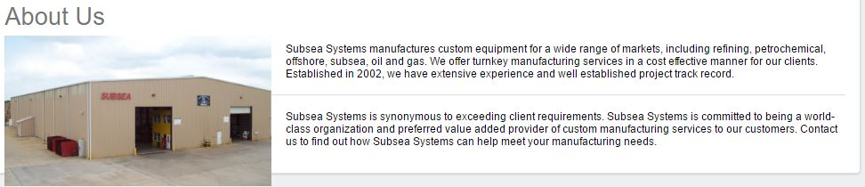
Comment-2
Please increase the text increase for all the content in the website to next size. The content looks very small.

Slide 4
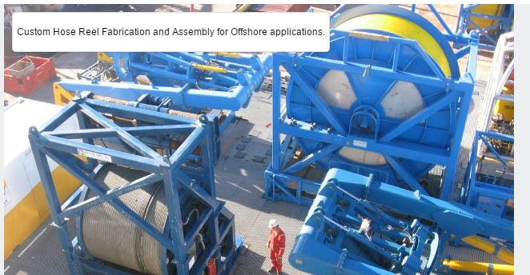

Comment-3
Keep the text as shown right side screen shot.
I suggest we should be able to position the Caption at 4 locations
left top or Left bottom or Right top/Right bottom. I want to use this text to hide sore objects (like bottle sprayer in a picture) etc. etc.

Slide 5
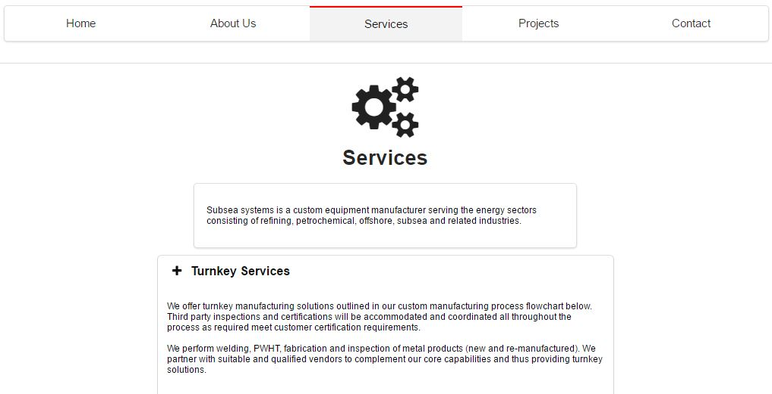
Comment-4
Change the background colour because it seams like both are coincide with each other.

Slide 6
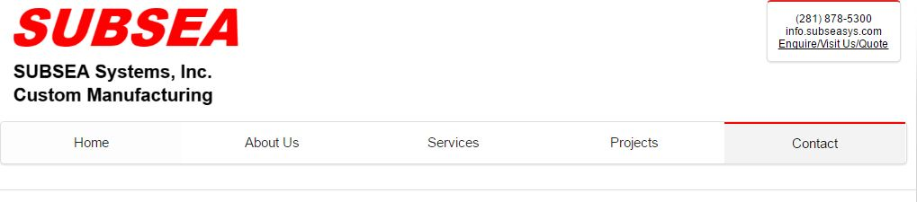
Comment-5
Excess white space is a waste. Use every pixel to our advantage. can we squeeze the menu between logo & content? In services and contact page the space having more comparing to home and about us page.

Slide 7
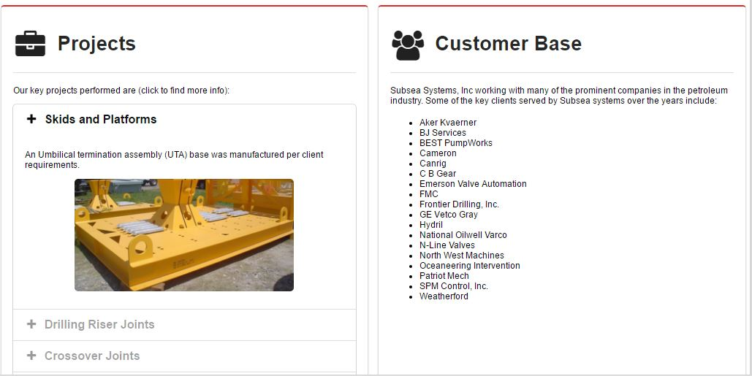
Comment-7
Please separate the projects and customer base.

Slide 8
Comment-8
we should have to provide the linkedin link and oilpro instead of Instagram, facebook and twitter in the website?

Slide 9
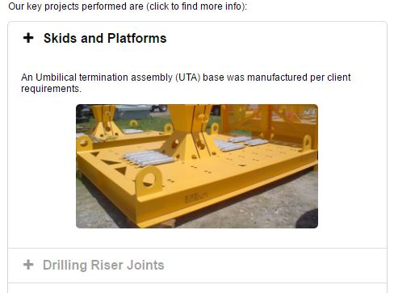
Comment-6
In projects while scrolling the key projects it’s showing the Plus symbol while scrolling keep negative symbol. Please highlight the image while keeping the mouse on image.

Slide 10
THANK YOU
For the opportunity to serve!

Slide 11
Document Revision History
01 | PRE-0001-01 Web report preview comments | 1 Sept 2016 |  | GSY | VA | ?
Rev | Description | Date |  | Author | Checked | Approved
Document No: |  |  | Client Ref:
PRE-0001-01 Web report preview comments |  |  | n/a

